Slide 1
How Effective was Graduate and Non-Traditional Student Communication when Applying to Lindenwood University?
Jennifer Sailor, Robby Hamilton, Alisa Wynn, Meredith Pool-Boerding

Slide 2
Introduction (as a group)
Participants
Contacted Graduate Professors
Reevaluated
Contacted any Professor
Focus Group
Recording and Transcribed Microsoft Teams
Reviewed Informed Consent
Demographic Form
Body Language Data Sheet
Analysis Based on Major

Slide 3
Limitations (as a group)
Researcher Bias
Traditional Students Influence
Demographic form not fully completed
Causing different sample sizes
Students not knowing what it means to be traditional or a non-traditional student
Had to rely on convenience sampling
Different Results from researchers
Notes:
Ex. finding evidence in the transcription of a student being nontraditional after previously stating that they were a traditional student

Slide 4
Data Science
Jennifer Sailor

Slide 5
Methods
1
Appendix A: Question Sheet
2
Focus Group: Moderating and Recording
3
Data Set: Transcription and Deidentification
4
Data Analysis: RStudio, Excel, Packages, and Edits
Notes:
1.
2. I was in charge of focusing and then we recording using microsoft teams for all except the first focus group which was done through big blue button
3. The microsoft teams transcription was edited by changing all yeah to yes and putting into a database which can be seen in appendix b
4. I took the transcription plugged it into my program software and used packages tidyverse, tidytext, and wordcloud.
All speakers of type Traditional, Staff, Researcher, and Professor were excluded from data analysis because of their irrelevance to research question.

Slide 6
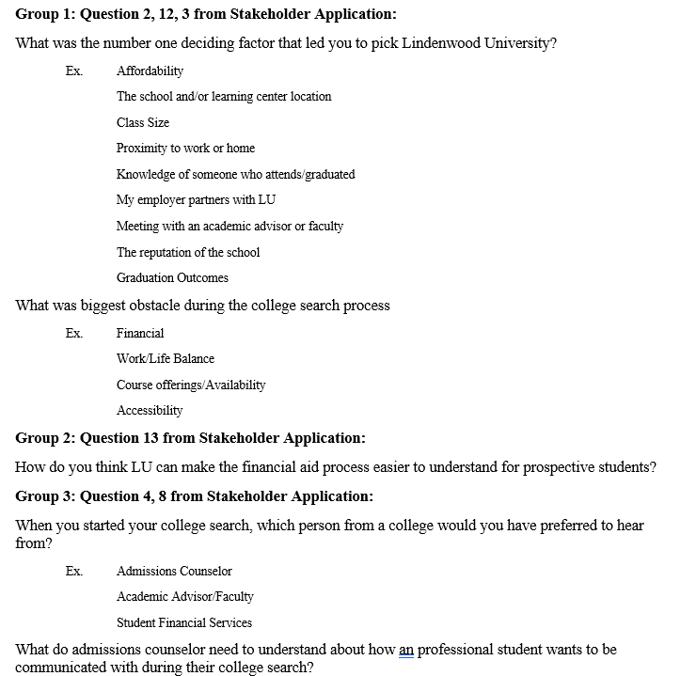
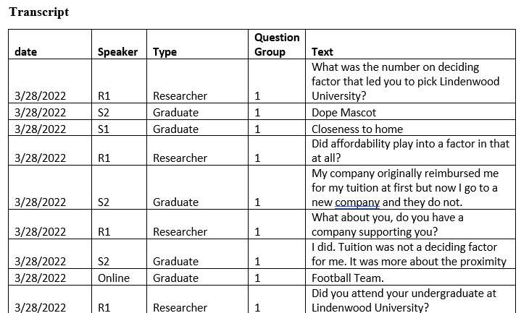
Methods
Notes:
1. I wanted to point out data, speaker, type, question group, and text
2. Additionally wanted to point out that from appendix a the questions are derived from the stakeholder application and adjusted to be open ended

Slide 7
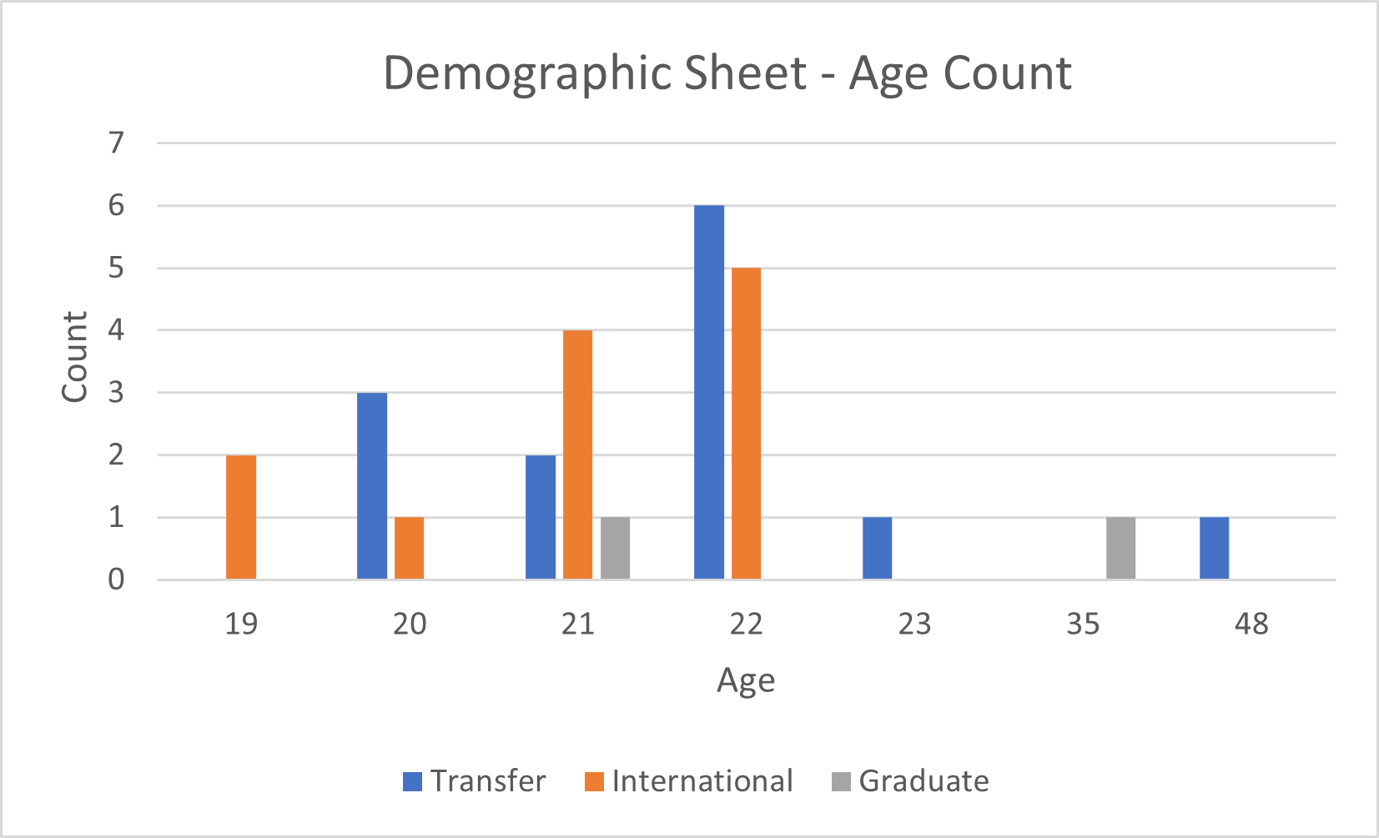
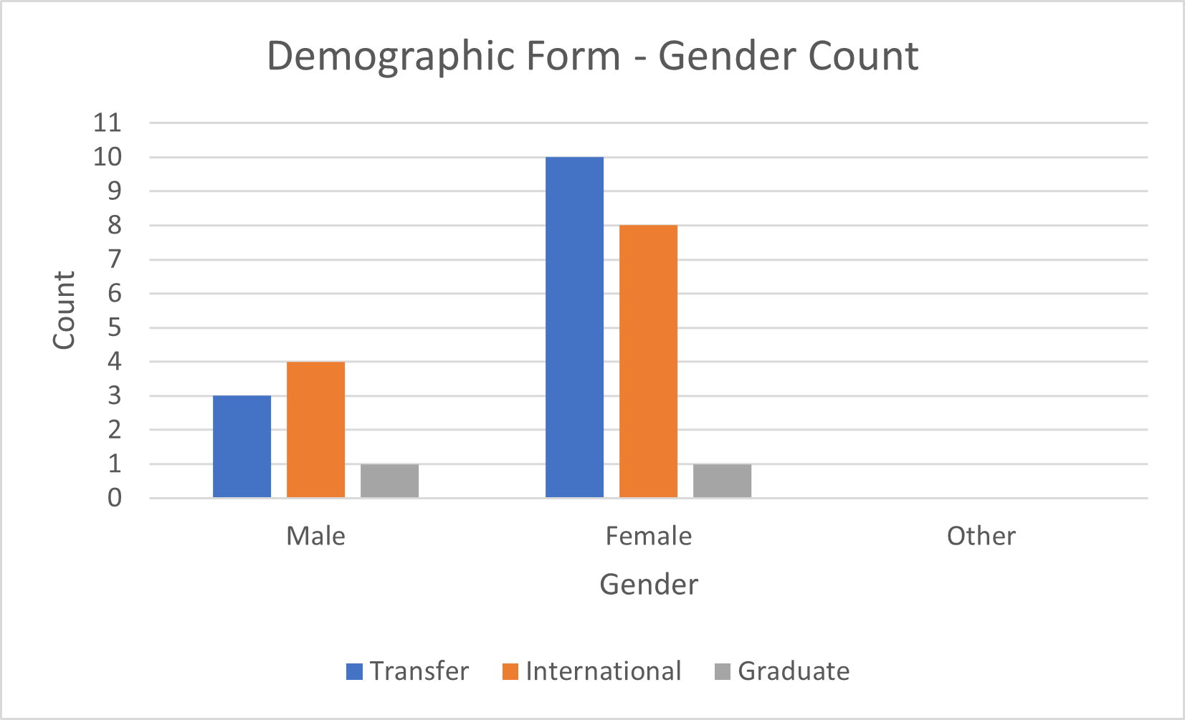
Demographic Forms
Notes:
- inclusion of Graduate – there is a ? Because one data sheet was missing at time of this analysis (that student was a graduate student so this only accounts for 2/ graduate students)
- This was only based off of demographic forms
- deeper dive into age

Slide 8
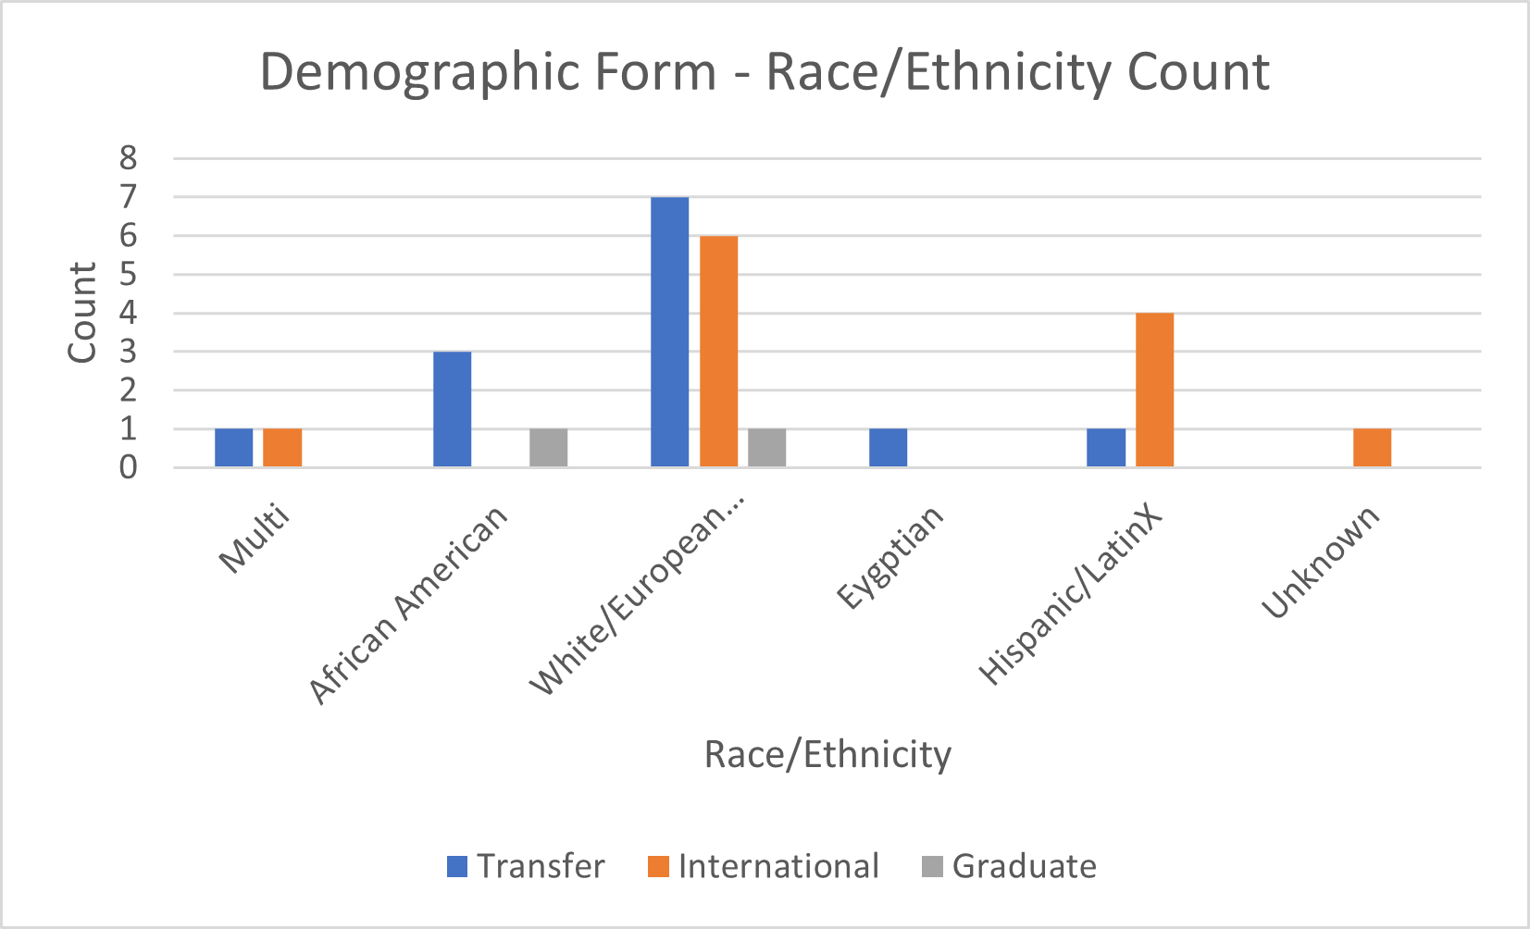
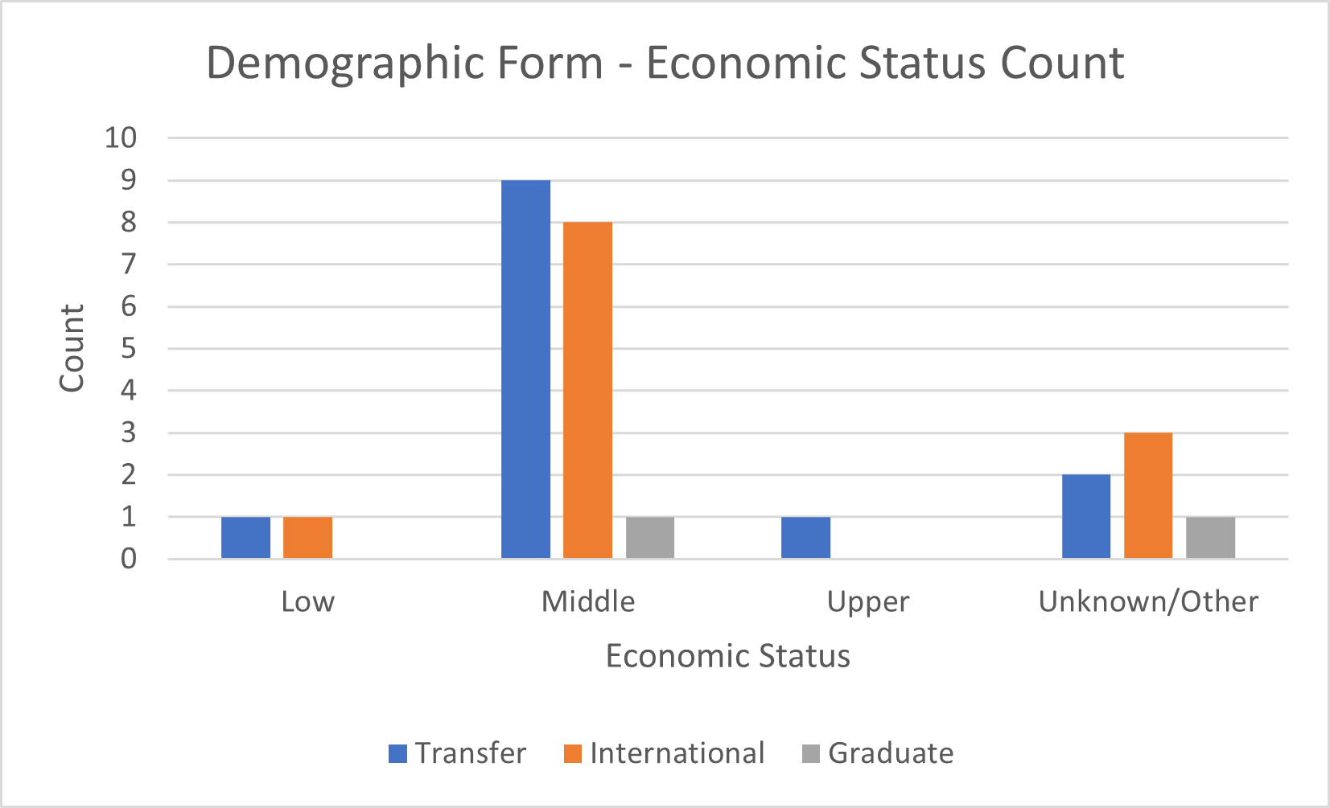
Demographic Forms
Notes:
- one difference in economic status could be because I classified "upper middle" class still under middle

Slide 9
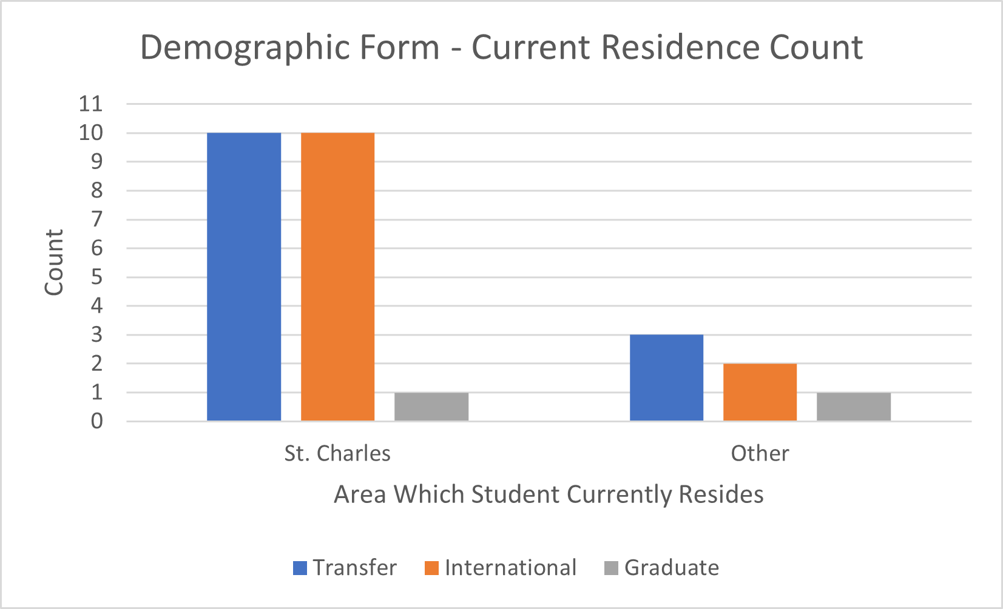
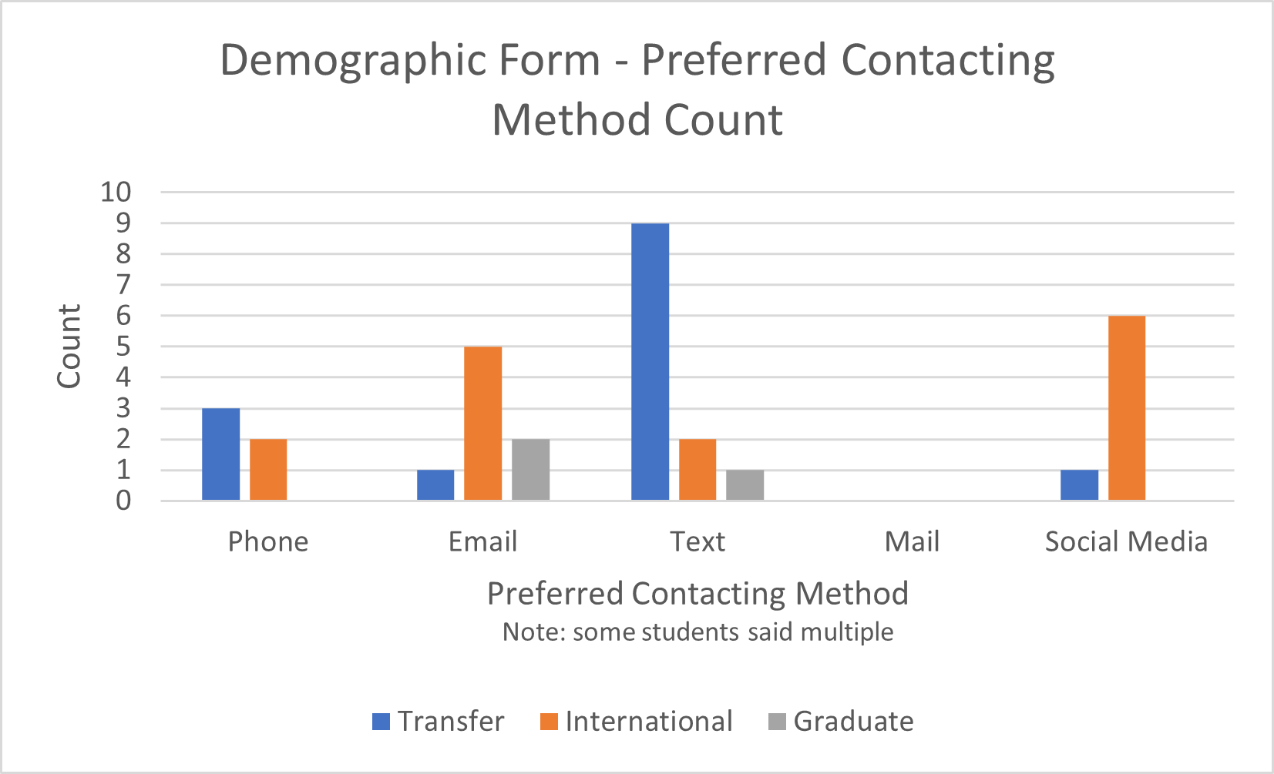
Demographic Forms
Notes:
- transfer resident and other are different than Robbys

Slide 10
Results
The Number (n) of Words Spoken by Each Type of Non-Traditional Student
Type | Number of Words Spoken
International | 3717
Adult Learner | 931
Graduate | 863
International and Transfer | 673
Transfer | 541
Applying Graduate and Transfer | 240
Results will be heavily influenced by International Students

Slide 11
Results
The Number (n) of Words Spoken by Type of Non-Traditional Student
Type | Number of Words Spoken | Number of Speakers | Average Words per Speaker
International | 3717 | 10 | 372
Adult Learner | 931 | 1 | 931
Graduate | 863 | 3 | 288
International and Transfer | 673 | 2 | 337
Transfer | 541 | 5 | 108
Applying Graduate and Transfer | 240 | 1 | 240
2
1
3
Results will be heavily influenced by an Adult Learner

Slide 12
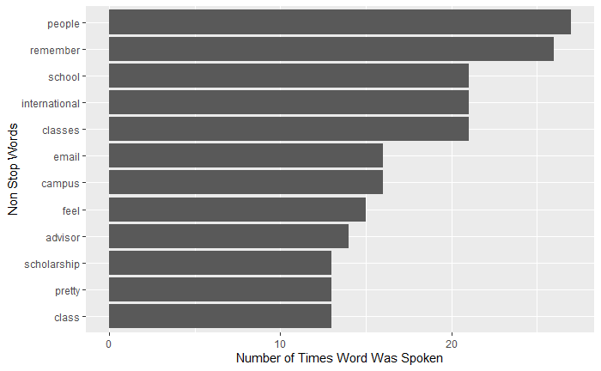
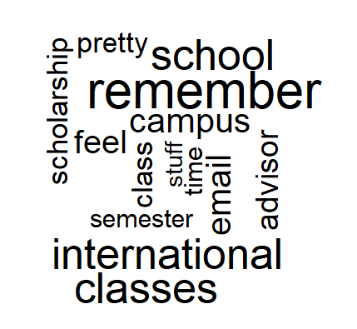
Results
What words were spoken the most?
It's important to see that international, email, advisor, and scholarship were in the top 10 because it tells to some of the answers to the questions and gives an idea of what the theme of the focus groups were.

Slide 13
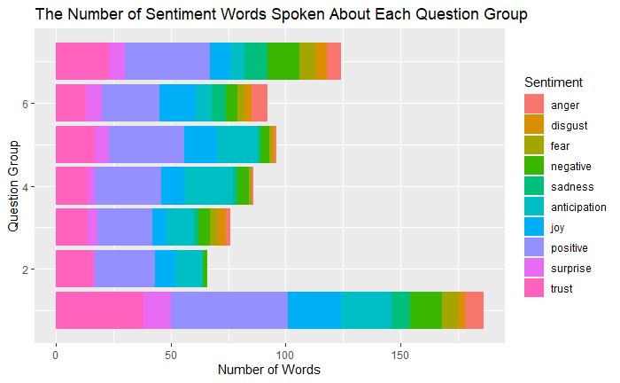
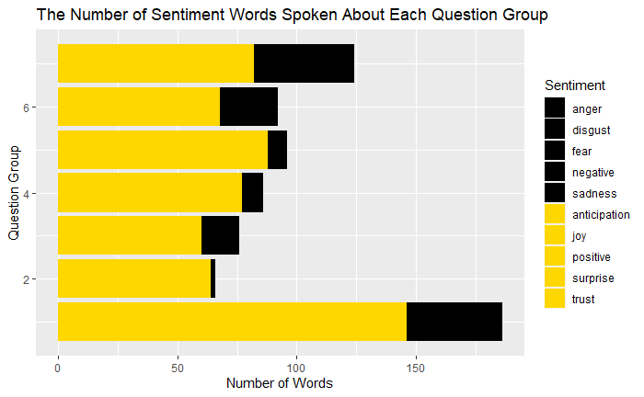
Results
What is the number of sentiment attached to each question group?
66/33
74/26
92/8
90/10
79/21
97/3
78/22
Overall lots of positive feedback however the most negative was question groups 7, 6, 1 and 3

Slide 14
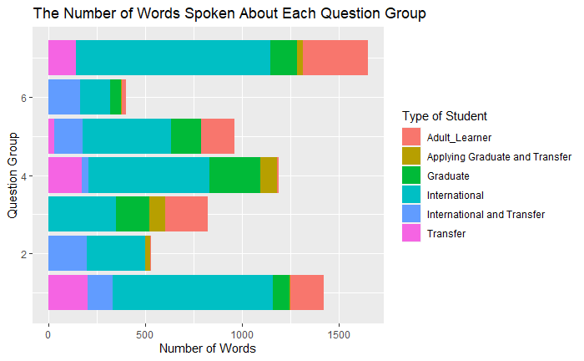
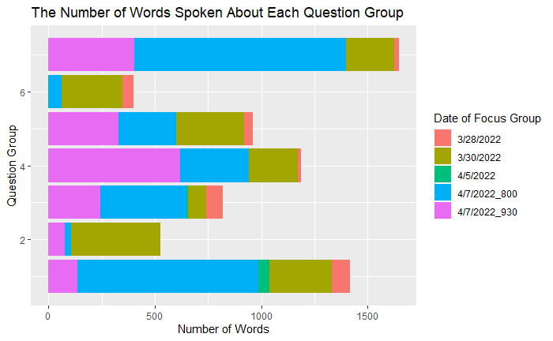
Results
What was the number of words spoken each question grouping?
These results show the importance of reading which sections of transcript to get the most relevant data to what the stakeholder wants to focus on

Slide 15
Results as Moderator
1
Emailing works best overall
2
Meeting with Academic Advisor
3
Clear depiction of fees
4
Map and Exclusive Tour of Classes
Notes:
1. Emailing for International is the way to go! Adult and Graduates also appreciate this! However it was noted that seeing the acceptance in there had made it feel more special! - reccomendation to ask how they would like to be notified
2. Many student did not like how they were assigned classes and did not meet with academic advisor to choose classes! - bring back lion day where you choose classes or make it a requirement to set up a meeting
3. Students who paid for school felt like it was obvious for what scholarship they got and what they had to pay for but was not aware that there would be increases to tuition, that books would be expensive and would change each semester on how much, and that scholarship would change if lived off campus
4. students felt like they didn't know where classes were or that Google maps should be improved or a mao should be given

Slide 16
Conclusion
1
Total of 28 Students, 22 Students were Non-Traditional, bias from International students as a whole and an Adult Learner as an individual
2
Communication by email was most effective
3
When wanting to look at how to improve Enrollment Management look at Question groups 1, 3, 6, and 7, however, overall, the admissions process was positive.
Limitations Researcher Specific
Inaccuracies in Transcription
Did not include 1 focus group
Missing a graduate demographic form

Slide 17
Overall Analysis

Slide 18
Sample Size
Robby
Alisa
Jennifer
Jennifer
Sample Size: 24
Information from:
Demographic Form
Not including Graduate Students
Sample Size: 28
Information from:
Demographic Form and labeling based on Transcription
Size: 27
(Demographic Analysis)
Information from:
Demographic Form
Not including 1 Graduate Demographic form
Sample Size: 22
(Transcription Analysis)
Information from:
Transcription
Not including 1 focus group

Slide 19
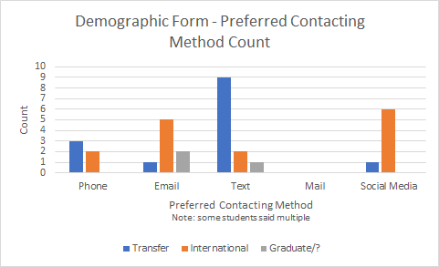
Preferred Method of Contact
Jennifer Demographic and Jennifer Figure 2

Slide 20
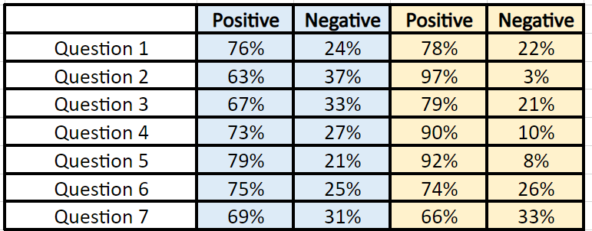
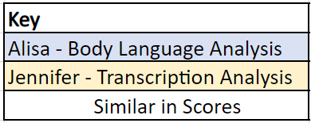
Comparing Feedback
~
~
~
~
Averages from Alisa Appendix F and Jennifer Figure 7
Notes:
Q1, Q6, and Q7 are very similar

Slide 21
Future Research Recommendation
Clarify definition of nontraditional
Ask traditional students to leave room
Have bullet points only on demographic form

Slide 22
Recommendations for Enrollment Management
Text Transfers and Internationals social media and email
Clarify Financial Aid Process
More appealing to middle class so they want to know where money is going and when it is going to change
Books, increase in tuition yearly, meal plans, changes in financial aid if live off campus
Meeting with Academic Advisor was negative
Sit down and choose classes
Give Map and Tour of Major Specific Buildings
Encourage hosting virtual visits, open houses, or other online events
Students are still happy to be at LU

Slide 23
As Applying Graduates...
We looked for..
Great Communication
Detailed Outline of Application Process without hunting
Easily Accessible/User Friendly Website
Link to Application obvious and simple
Feedback from current Graduate Students
Meeting with Faculty in department
We don't like...
Spam calls
Unclear scholarship information at time of acceptance

